Slide 1
COVID-19 Vaccinations Trend Analysis

Slide 2
AIM:
The aim of the project is to analyze the data in detail by using people vaccinated and people fully vaccinated according to the date and year.

Slide 3
INTRODUCTION:
The main purpose of the project is to analyse various kinds of covid-19 vaccination details so that we can be able to understand different vaccination throughout the world we can derive some recommendations, Insights and can bring out a conclusion.

Slide 4
PROBLEM STATEMENT:
In our project we need to find, how many people are vaccinated and fully vaccinated in the years 2021 and 2022.
Need to analyze the top 10 vaccinated countries.
Need to analyze the top 10 daily vaccinated countries.
Need to analyze all vaccination details.

Slide 5
Methodology:
STEP 1- DATA IMPORTING.
The given dataset CSV file needs to be imported into the power bi software and click the load option.
STEP 2- DATA CLEANING.
After analyzing the, we have found that the null value has to be changed. For this replace option is used to replace null with 0.
STEP 3- VISULAIZATION
For visualization I have used some tables, graphs and charts for the best presentation and visualization.

Slide 6
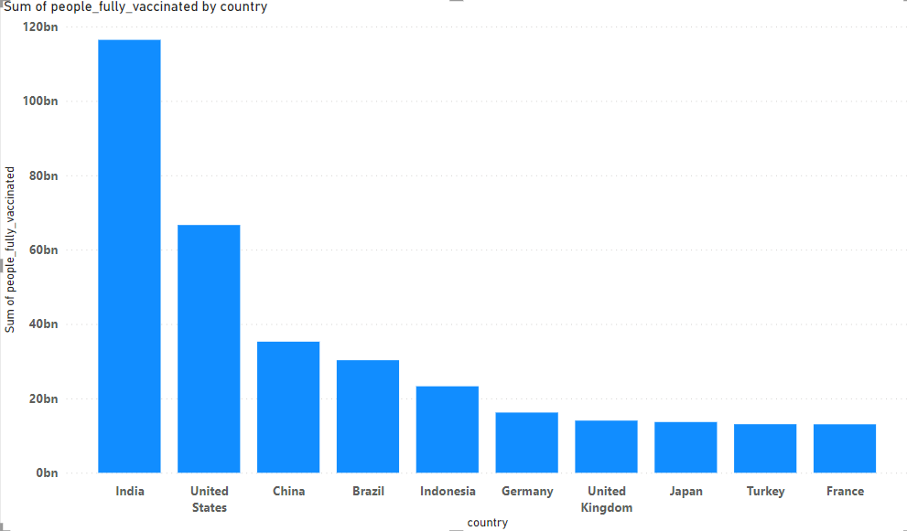
ANALYSIS:
In this part, first I have analyzed the top 10 countries where people are fully vaccinated. From the image shown below, we
know the top 10 countries for people fully vaccinated.
From the above analysis, India is in first from people fully vaccinated countries. And the top 10 countries are fully vaccinated,
are shown clearly.

Slide 7
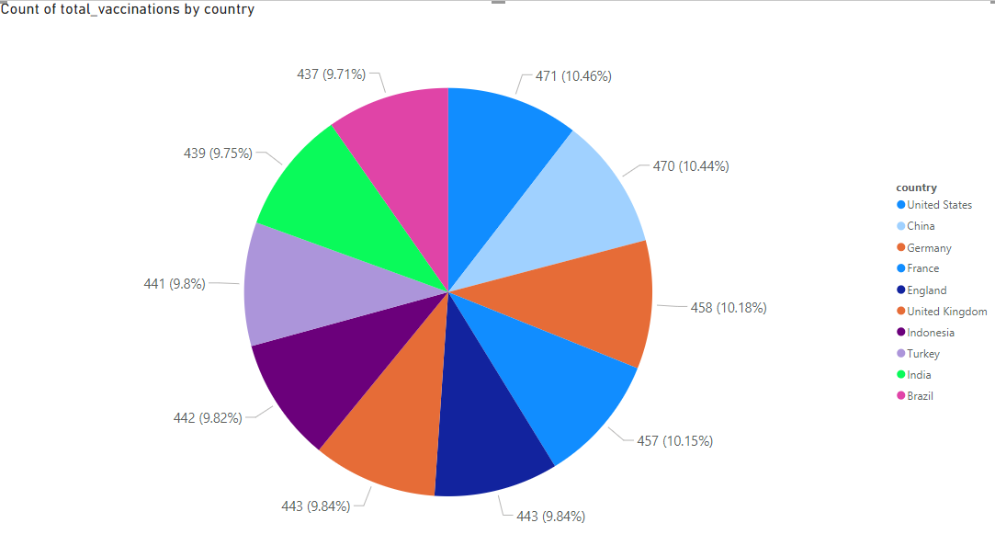
In the second analysis, According to country-wise, the total vaccinations are shown in pie chart.

Slide 8
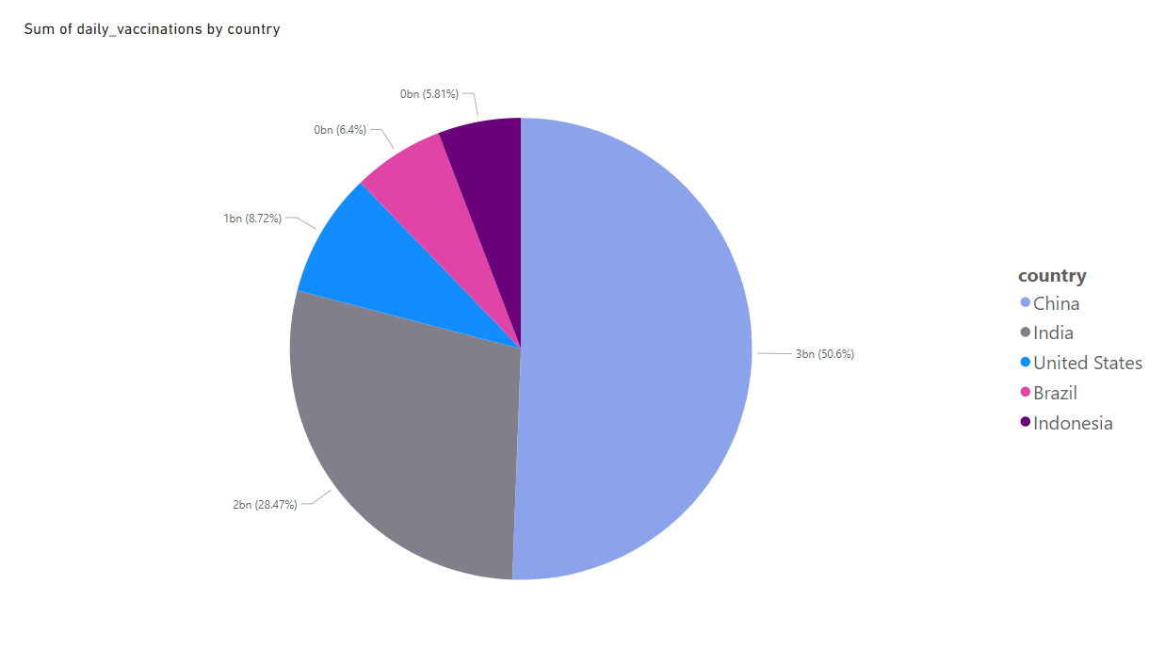
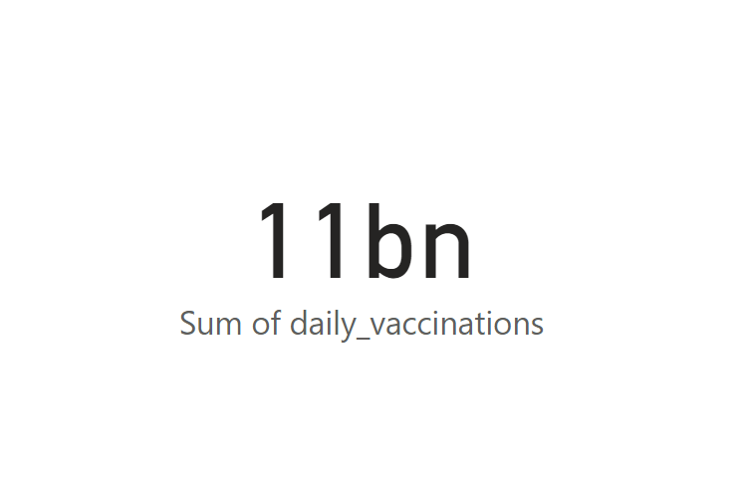
In the third analysis, According to country-wise, the daily vaccinations are shown in pie chart.

Slide 9
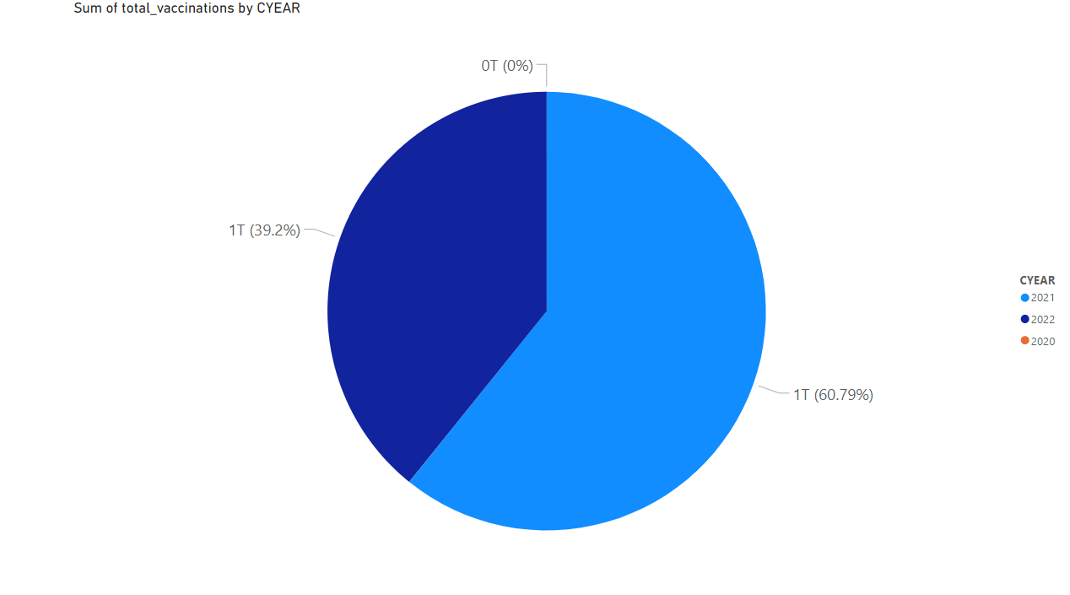
In the fourth analysis, According to year,the vaccinations are shown in pie chart.
In the fourth analysis, According to year,the vaccinations are shown in pie chart

Slide 10
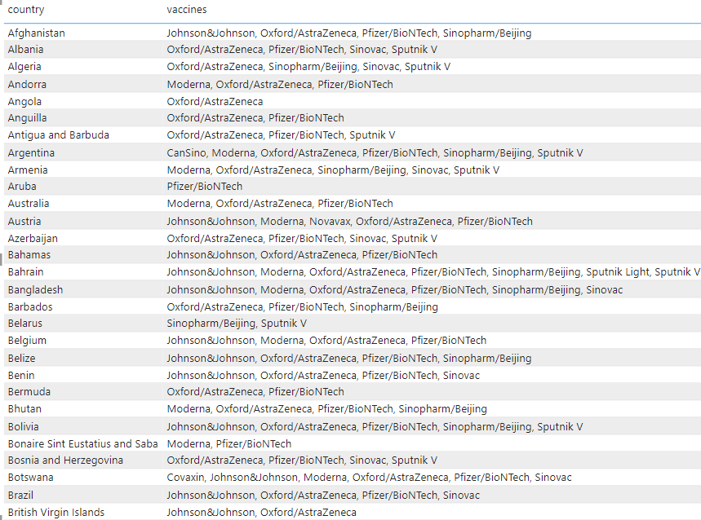
From the above analysis, China is number 1 in total vaccinations compared to other countries.
In year-wise 2021 is more vaccinated compared to 2022 and In 2020, no one was vaccinated.
China, India, The united states, Brazil, Indonesia and the remaining countries are top 10 full vaccinations.
Insights:
Here we analyzed the top 10 fully vaccinated countries in which India tops the list which indicates that people in the country were showing lots of interests to get vaccinated.

Slide 11
And also analyzed the top 5 vaccinated countries here also India tops the list then analyzed the top 5 daily vaccinating countries and here China tops the list also analyse the sum of daily vaccinating details, fully vaccinating and vaccinating people details.
year wise analysis shows that 2021 was the peak year for every vaccination details.
Recommendations:
We should collect day to day reports, and we should update our records daily to get more accurate details.
So that we can move forward with more vaccination to the right country which needs the most.
Conclusion:
From the given data, we know that country-wise the people are vaccinated.
Every country took actions in providing vaccine to people.

